Slide 1
Presentation Title
Introduction to Machine Learning
H M Sabbir Ahmad
Ph.D., Systems Engineering.
09/12/2024

Slide 2
What is Machine Learning?
“Learning is any process by which a system improves performance from experience.”
- Herbert Simon
Definition by Tom Mitchell (1998):
Machine Learning is the study of algorithms that
improve their performance P
at some task T
with experience E.
A well-defined learning task is given by <P, T, E>.
3

Slide 3
Traditional Programming
Data Program
Computer
Output
Machine Learning
Data Output
Computer
Program
Slide credit: Pedro Domingos

Slide 4
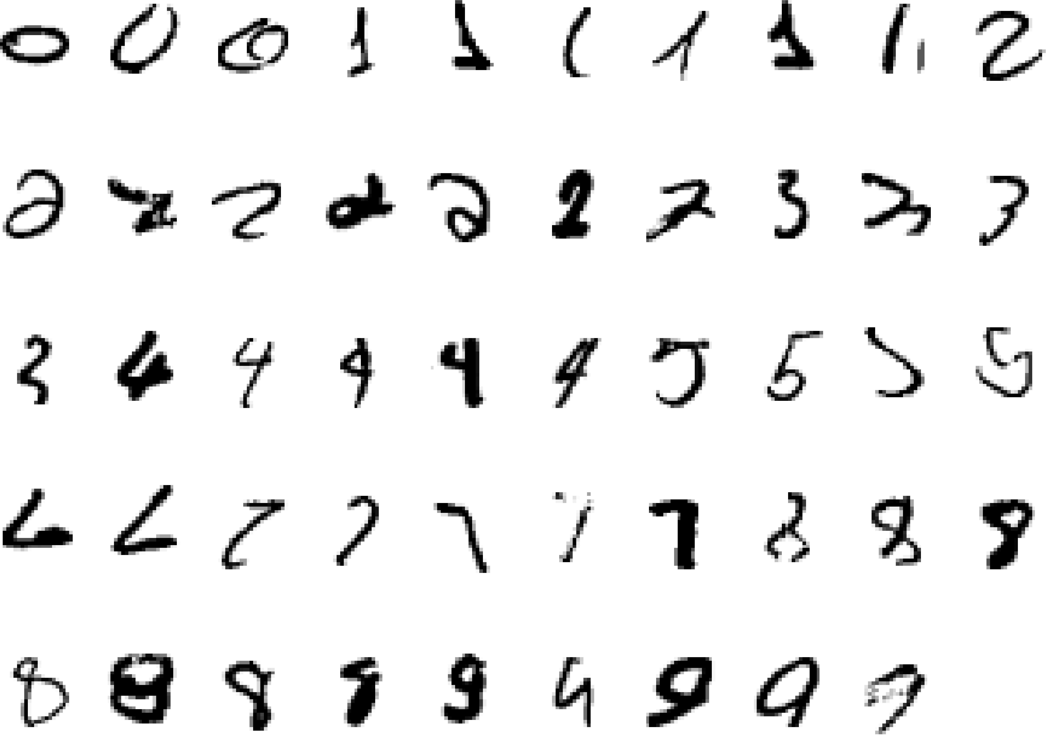
A classic example of a task that requires machine learning: It is very hard to say what makes a 2
What is Machine Learning?
Slide credit: Geoffrey Hinton

Slide 5
Some more examples of tasks that are best solved by using a learning algorithm
Recognizing patterns:
Facial identities or facial expressions
Handwritten or spoken words
Medical images
Generating patterns:
Generating images or motion sequences
Recognizing anomalies:
Unusual credit card transactions
Unusual patterns of sensor readings in a nuclear power plant
Prediction:
Future stock prices or currency exchange rates
Slide credit: Geoffrey Hinton

Slide 6
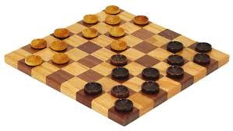
Samuel’s Checkers-Player
“Machine Learning: Field of study that gives computers the ability to learn without being explicitly programmed.” -Arthur Samuel (1959)

Slide 7
Types of Learning
Supervised (inductive) learning
– Given: training data + desired outputs (labels)
• Unsupervised learning
– Given: training data (without desired outputs)
• Semi-supervised learning
– Given: training data + a few desired outputs
• Reinforcement learning
– Rewards from sequence of actions
Slide credit: Pedro Domingos

Slide 8



Supervised Learning: Regression
Given (x₁, y₁), (x₂, y₂), ..., (x_{n}, y_{n})
Learn a function f(x) to predict y given x
– y is real-valued == regression
9
8
7
6
5
4
3
2
1
0
1970 1980
September Arctic Sea Ice Extent (1,000,000 sq km)
1990 2000
2010
2020
Year
Data from G. Witt. Journal of Statistics Education, Volume 21, Number 1 (2013)

Slide 9










Supervised Learning: Classification
Given (x₁, y₁), (x₂, y₂), ..., (x_{n}, y_{n})
Learn a function f(x) to predict y given x
– y is categorical == classification
Breast Cancer (Malignant / Benign)
1(Malignant)
0(Benign)
Tumor Size
Slide credit: Andrew Ng

Slide 10








Supervised Learning: Classification
Given (x₁, y₁), (x₂, y₂), ..., (x_{n}, y_{n})
Learn a function f(x) to predict y given x
– y is categorical == classification
Breast Cancer (Malignant / Benign)
1(Malignant)
0(Benign)
Tumor Size
Predict Benign Predict Malignant
Tumor Size
Slide credit: Andrew Ng

Slide 11











Supervised Learning
x can be multi-dimensional
– Each dimension corresponds to an attribute
Clump Thickness
Uniformity of Cell Size
Uniformity of Cell Shape
…
Age
Tumor Size
Slide credit: Andrew Ng

Slide 12
















Unsupervised Learning
Given x₁, x₂, ..., x_{n} (without labels)
Output hidden structure behind the x’s
– E.g., clustering
Slide credit: Andrew Ng

Slide 13











Unsupervised Learning
Organize computing clusters
Social network analysis
Market segmentation
33
Slide credit: Andrew Ng

Slide 14
Reinforcement Learning
Given a sequence of states and actions with (delayed) rewards, output a policy
Policy is a mapping from states → actions that tells you what to do in a given state
Examples:
Game playing
Robot in a maze
Balance a pole on your hand
36

Slide 15
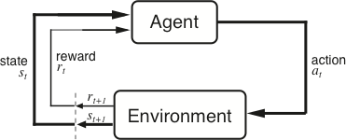
The Agent-Environment Interface
Agent and environment interact at discrete time steps Agent observes state at step t : s_{t} ∈S
: t = 0, 1, 2, K
produces action at step t : a_{t} ∈ A(s_{t} )
gets resulting reward : and resulting next state :
r_{t +1} ∈ℜ
^{s}t +1
. . .
^{r}t +1 _{st +1}
^{r}t +2 _{st +2}
^{r}t +3
. . .
s
t
a_{t}
^{s}t +3
ªt +1
ªt +2
ªt +3
37
Slide credit: Sutton & Barto
Notes:
Modify to point the circles

Slide 16

Reinforcement Learning
https://www.youtube.com/watch?v=4cgWya-wjgY

Slide 17
Neural Networks Supervised learning

Slide 18
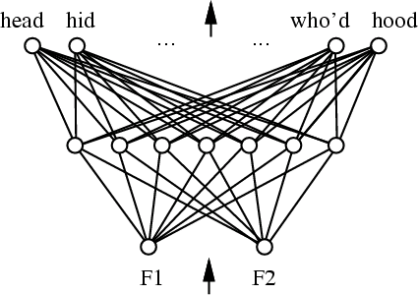
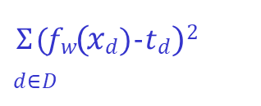
Artificial Neural Networks to learn f: X → Y
f_{𝐰} typically a non-linear function, f_{𝐰}: X → Y
X feature space: (vector of) vars
Y output space: (vector of) vars
f_{𝐰} network of basic units
Learning algorithm: given (𝑥_{𝑑}, 𝑡_{𝑑})_{𝑑∈𝐷}, train weights w of all units
to minimize sum of squared errors of predicted network outputs.
$Σ$(𝑓_{𝑤}(𝑥_{𝑑})-𝑡_{𝑑})²
𝑑∈𝐷
Find parameters w to minimize
Use gradient descent!
Slide Credit: Tom Mitchell and Maria Florina Balcan

Slide 19
What type of units should we use?
Classifier is a multilayer network of units.
Each unit takes some inputs and produces one output. Output of one unit can be the input of another.
Input layer
Hidden layer
Output layer
1
0.5
0.3
Slide Credit: Tom Mitchell and Maria Florina Balcan

Slide 20
Multilayer network of Linear units?
Advantage: we know how to do gradients on linear units
Input layer
Hidden
layer
Output layer
𝑥₀ = 1
^{𝑤}0,2
^{𝑤}0,1
^{𝑤}1,1
^{𝑤}2,1
𝑣₁ = 𝒘_{𝟏} ⋅ 𝒙
^{𝑤}3,1
𝑥
1
𝑧 = 𝒘_{𝟑} ⋅ 𝒗
^{𝑤}1,2
𝑤
3,2
𝑥₂
^{𝑤}2,2
𝑣₂ = 𝒘_{𝟐} ⋅ 𝒙
Problem: linear of linear is just linear.
𝑧 = 𝑤_{3,1} 𝒘_{𝟏} ⋅ 𝒙 + 𝑤_{3,2} 𝒘_{𝟐} ⋅ 𝒙 =
^{𝑤}3,1^{𝒘}𝟏 ^{+ 𝑤}3,2^{𝒘}𝟐
⋅ 𝒙 = linear
Slide Credit: Tom Mitchell and Maria Florina Balcan

Slide 21
Multilayer network of Perceptron units?
Advantage: Can produce highly non-linear decision boundaries!
Input layer
Hidden
layer
Output layer
𝑥₀ = 1
^{𝑤}0,1
^{𝑤}1,1
^{𝑤}2,1
𝑣 = (𝒘 ⋅ 𝒙)
^{𝑤}3,1
^{𝑤}0,2
1 𝟏
𝑥
1
𝑧 = (𝒘₃⋅ 𝒗)
^{𝑤}1,2
𝑤
3,2
𝑥₂
^{𝑤}2,2
𝑣₂ = (𝒘_{𝟐}⋅ 𝒙)
Threshold function: 𝑥 = 1 if 𝑥 is positive, 0 if 𝑥 is negative.
Problem: discontinuous threshold is not differentiable. Can’t do gradient descent.
Slide Credit: Tom Mitchell and Maria Florina Balcan

Slide 22
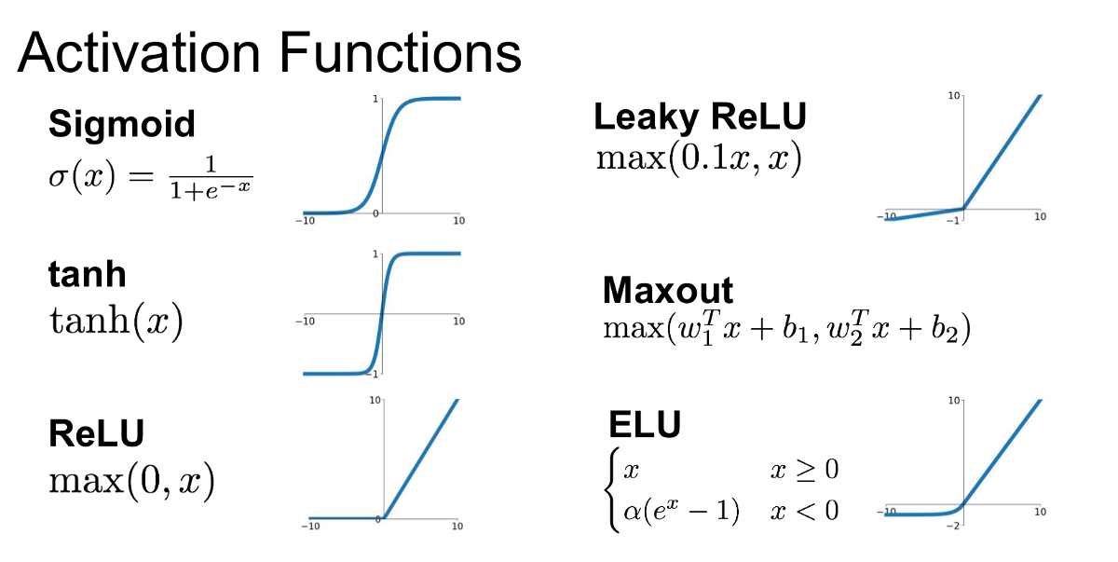

Slide 23

Multilayer network of sigmoid units
Advantage: Can produce highly non-linear decision boundaries!
Sigmoid is differentiable, so can use gradient descent
Input layer
Hidden layer
Output layer
𝑥₀ = 1
^{𝑤}0,2
^{𝑤}0,1
^{𝑤}1,1
^{𝑤}2,1
𝑣 = 𝝈(𝒘 ⋅ 𝒙)
^{𝑤}3,1
1
𝟏
𝑥
1
𝑧 = 𝝈(𝒘_{𝟑}⋅ 𝒗)
^{𝑤}1,2
𝑤
3,2
𝑥₂
^{𝑤}2,2
𝑣₂ = 𝝈(𝒘_{𝟐}⋅ 𝒙)
1
1 + 𝑒^{−𝑥}
𝝈 𝑥 =
=
Very useful in practice!
Slide Credit: Tom Mitchell and Maria Florina Balcan

Slide 24
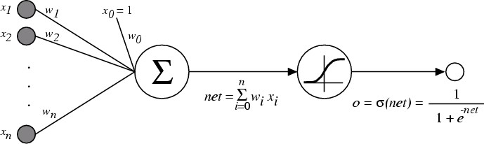

The Sigmoid Unit
𝜎 is the sigmoid function; 𝜎 𝑥 =
1
1+𝑒^{−𝑥}
Nice property:
𝑑𝜎 𝑥
= 𝜎 𝑥
1 − 𝜎 𝑥
𝑑𝑥
We can derive gradients to train and learn the parameters:
One sigmoid unit
Multilayer networks of sigmoid units → Backpropagation
Slide Credit: Tom Mitchell and Maria Florina Balcan

Slide 25
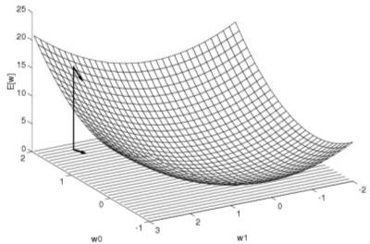
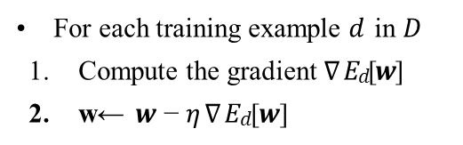
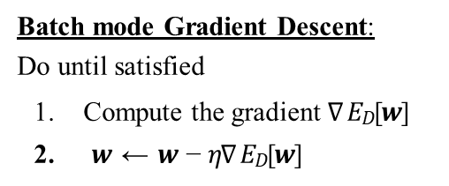

Gradient Descent to Minimize Squared Error
Goal: Given 𝑥 , 𝑡 find w to minimize 𝐸_{D} $[w]$ =
$Σ$(𝑓_{𝑤}(𝑥_{𝑑})-𝑡_{𝑑})²
𝑑 𝑑 𝑑∈𝐷
Batch mode Gradient Descent: Do until satisfied
1. Compute the gradient $∇$𝐸_{𝐷}[𝒘]
2. 𝒘 ← 𝒘 − 𝜂$∇$𝐸_{𝐷}[𝒘]
Mode 1
𝜕𝐸 , 𝜕𝐸 , … , 𝜕𝐸
𝜕𝑤₀ 𝜕𝑤₁ 𝜕𝑤_{𝑛}
$∇$𝐸 𝒘 ≡
Incremental (stochastic) Gradient Descent: Do until satisfied
Mode 2
For each training example 𝑑 in 𝐷
Compute the gradient $∇$𝐸_{𝑑}[𝒘]
2. w← 𝒘 − 𝜂 $∇$𝐸_{𝑑}[𝒘]
Note: Incremental Gradient Descent can approximate Batch Gradient Descent
arbitrarily closely if 𝜂 made small enough
Slide Credit: Tom Mitchell and Maria Florina Balcan

Slide 26
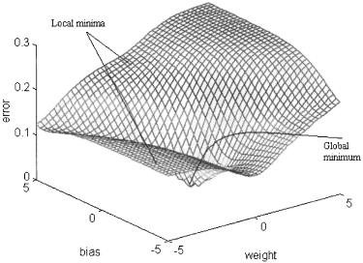
Gradient descent in weight space
Goal: Given 𝑥 , 𝑡 find w to minimize 𝐸_{D} $[w]$ =
$\frac{1}{2}Σ$(𝑓_{𝑤}(𝑥_{𝑑})-𝑡_{𝑑})²
𝑑 𝑑 𝑑∈𝐷
This error measure defines a surface over the "weight" space
figure from Cho & Chow, Neurocomputing 1999
w₂
w₁
Slide Credit: Tom Mitchell and Maria Florina Balcan

Slide 27


Gradient descent in weight space
Gradient descent is an iterative process aimed at finding a minimum in the error surface.
on each iteration
current weights define a
point in this space
find direction in which error surface descends most steeply
take a step (i.e. update
weights) in that direction
Error
w₁
w₂
Slide Credit: Tom Mitchell and Maria Florina Balcan

Slide 28


Gradient descent in weight space
Calculate the gradient of E: ∇E(w) = ^{⎡ ∂E} , ^{∂E} ,
$$…$$
, ∂E ⎤
⎢∂w ∂w
∂w ⎥
⎣ 0
1
n ⎦
Take a step in the opposite direction
Δw = −η ∇E(w)
Error
Δw = −η ^{∂E}
i
∂w
i
w₁
∂E
⁻ ∂w
1
w₂
₋ ∂E
Slide Credit: Tom Mitchell and Maria Florina Balcan
∂w₂

Slide 29
Taking derivative: chain rule
Recall the chain rule from calculus
y = f (u)
u = g(x)
∂y ₌ ∂y ∂u
∂x ∂u ∂x
Slide Credit: Tom Mitchell and Maria Florina Balcan

Slide 30
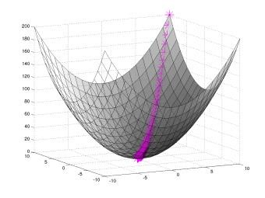
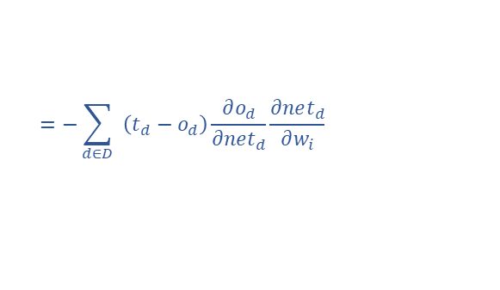
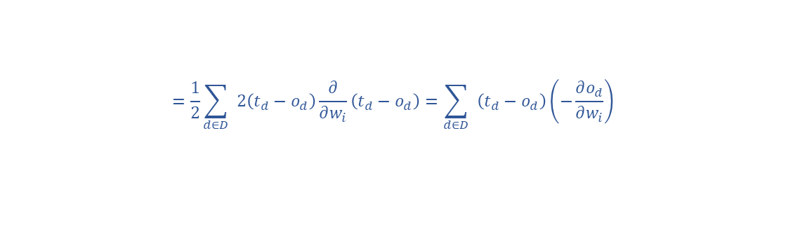
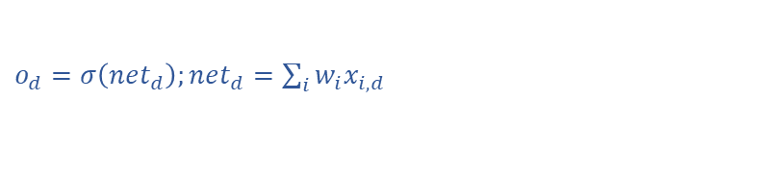
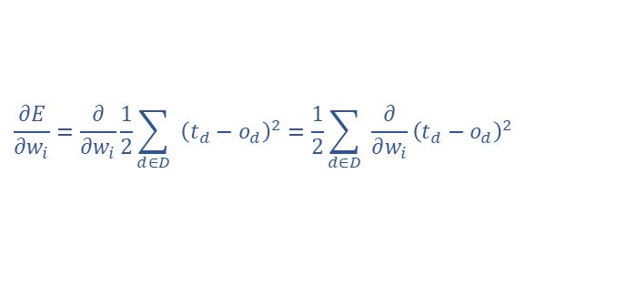
Gradient Descent for the Sigmoid Unit
𝑥_{𝑑}, 𝑡_{𝑑 𝑑∈𝐷} find w to minimize
Given
$$Σ_{d∈D}{\left(o_{d^{−}}t_{d}\right)}^{2}$$
$o_{d}=$observed output for $x_{d}$
$o_{d}=σ\left(net_{d}\right);net_{d}=\sum_{i}{w_{i}x_{i,d}}$
$$\frac{∂E}{∂w_{i}}=\frac{∂}{∂w_{i}}\frac{1}{2}\sum_{d∈D}{ } {\left(t_{d}−o_{d}\right)}^{2}=\frac{1}{2}\sum_{d∈D}{ } \frac{∂}{∂w_{i}}{\left(t_{d}−o_{d}\right)}^{2}$$
$$=\frac{1}{2}\sum_{d∈D}{ } 2\left(t_{d}−o_{d}\right)\frac{∂}{∂w_{i}}\left(t_{d}−o_{d}\right)=\sum_{d∈D}{ } \left(t_{d}−o_{d}\right)\left(−\frac{∂o_{d}}{∂w_{i}}\right)$$
$$=−\sum_{d∈D}{ } \left(t_{d}−o_{d}\right)\frac{∂o_{d}}{∂net_{d}}\frac{∂net_{d}}{∂w_{i}}$$
But we know: $\frac{∂o_{d}}{∂net_{d}}=\frac{∂σ\left({ \text{net} }_{d}\right)}{∂net_{d}}=o_{d}\left(1−o_{d}\right)$ and $\frac{∂net_{d}}{∂w_{i}}=\frac{∂\left(w⋅x_{d}\right)}{∂w_{i}}=x_{i,d}$ So: $\frac{∂E}{∂w_{i}}=−∑_{d∈D} \left(t_{d}−o_{d}\right)o_{d}\left(1−o_{d}\right)x_{i,d}$
Slide Credit: Tom Mitchell and Maria Florina Balcan

Slide 31
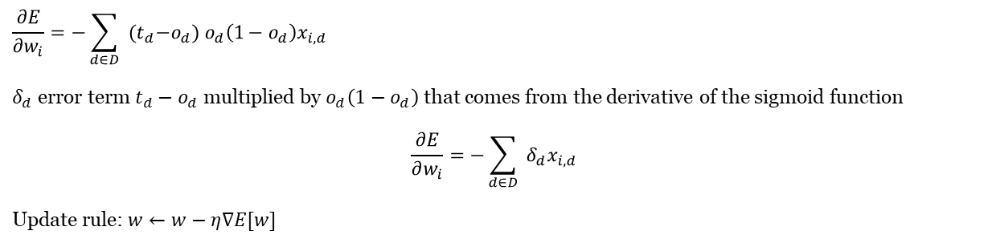

Gradient Descent for the Sigmoid Unit
(𝑥_{𝑑}, 𝑡_{𝑑})_{𝑑∈𝐷} find w to minimize $Σ_{d∈D}{\left(o_{d^{−}}t_{d}\right)}^{2}$
Given
$o_{d}=$observed output for $x_{d}$
$o_{d}=σ\left(net_{d}\right);net_{d}=\sum_{i}{w_{i}x_{i,d}}$
$$\frac{∂E}{∂w_{i}}=−\sum_{d∈D}{ } {(t}_{d}−o_{d}) o_{d}\left(1−o_{d}\right)x_{i,d}$$
$δ_{d}$ error term $t_{d}−o_{d}$ multiplied by $o_{d}\left(1−o_{d}\right)$ that comes from the derivative of the sigmoid function
$$\frac{∂E}{∂w_{i}}=−\sum_{d∈D}{ }δ_{d}x_{i,d}$$
Update rule: $w←w−η∇E[w]$
Slide Credit: Tom Mitchell and Maria Florina Balcan

Slide 32

Incremental/stochastic gradient descent
Backpropagation Algorithm
ℎ
Initialize all weights to small random numbers.
Until satisfied, Do:
For each training example (𝑥, 𝑡) do:
𝑘
Input the training example to the network and compute the network outputs
For each output unit 𝑘:
𝛿_{𝑘} ← 𝑜_{𝑘}(1 − 𝑜_{𝑘})(𝑡_{𝑘} − 𝑜_{𝑘})
3. For each hidden unit ℎ:
o = observed unit output
t = target output x = input
x_{i,j} = 𝑖th input to 𝑗th unit
w_{ij} = wt from i to j
𝛿_{ℎ} ← 𝑜_{ℎ} 1 − 𝑜_{ℎ}
$Σ_{k ∈ outputs}$^{𝑤}ℎ,𝑘^{𝛿}𝑘
4. Update each network weight 𝑤_{𝑖,𝑗}
^{𝑤}𝑖,𝑗 ^{← 𝑤}𝑖,𝑗 ^{+ Δw}𝑖,𝑗
where Δ𝑤_{𝑖,𝑗} = 𝜂𝛿_{𝑗}𝑥_{𝑖,𝑗}
Slide Credit: Tom Mitchell and Maria Florina Balcan

Slide 33
The End
Thanks for your attention.
I would be glad if you have any question.

